Slide 1

FINAL REVIEW DDoS Protection System for Cloud: Architecture and Tool Project Category : RESEARCH
Supervisor Name Dr. Balaji Srikaanth P, AP/NWC Dr. S. Nagendra Prabhu, AP/CINTEL | Batch No. NW000156 Shaurya Singh Srinet – RA2111032010006 Shounak Chandra – RA2111032010026 Charvi Jain – RA2111047010113

Slide 2
Abstract
Increasing cloud adoption heightens the risk of DDoS attacks, threatening service availability and data security.
We propose a scalable DDoS Protection System designed for real-time detection and mitigation in cloud environments.
Utilizes a multi-layered architecture with machine learning to distinguish between malicious and legitimate traffic patterns.
Ensures seamless integration across various cloud platforms while maintaining performance and minimizing false positives.
Aligns with industry security standards to safeguard data integrity and service continuity.

Slide 3
Introduction
Proposed Solution:
Cloud-native DDoS Protection System using machine learning for real-time anomaly detection and automated traffic filtering.
Differentiates between malicious and legitimate traffic to ensure continuous service.
Key Features:
Scalable and adaptable to various cloud architectures.
Compliant with industry standards for data integrity and security.
Impact:
Handles high traffic volumes (many Mbps) while maintaining optimal cloud resource utilization.
Ensures uninterrupted user experience with no service degradation or increased latency.
Adapts over time, improving detection and response by learning emerging attack patterns.

Slide 4
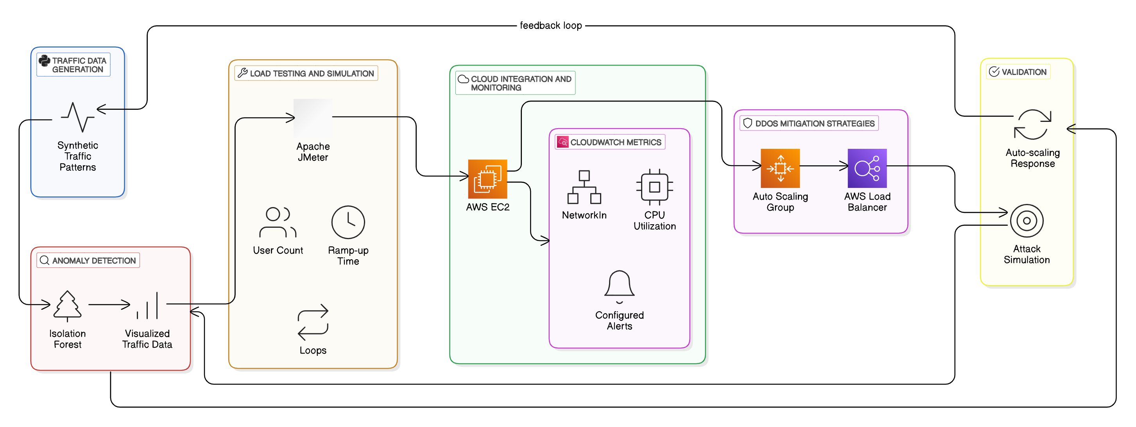
Architecture Diagram

Slide 5
Final Model and System Evaluation
Anomaly Detection and Mitigation:
Model successfully detects and mitigates complex DDoS attacks, including advanced volumetric and application-layer threats.
Seamless integration with AWS services to trigger automated mitigation actions (e.g., traffic filtering, scaling).
System Validation:
Comprehensive testing was conducted under real-world traffic patterns.
The system effectively mitigates attacks while maintaining performance and minimizing false positives.

Slide 6
Performance Results
Traffic Simulation Testing:
Conducted extensive testing using JMeter to simulate both normal and DDoS traffic patterns.
Tested across various cloud platforms to ensure cross-platform compatibility.
Real-Time Performance:
Results showed that the system maintained optimal resource utilization while effectively mitigating DDoS attacks.

Slide 7
Next Steps and Future Work
Post-Deployment Monitoring:
Continue monitoring the system's performance in live cloud environments.
Identify any emerging attack patterns and optimize the model further.
Scalability and Deployment:
Full deployment across multiple cloud platforms.
Ensure scalability under varying levels of attack traffic and cloud resource demands.
Documentation and Reporting:
Prepare final documentation for deployment and system maintenance.
Develop a report on the system's performance, optimizations, and future improvements.

